Slide 1
First-in-Human Trial of MK-8591-Eluting Implants Demonstrates
Concentrations Suitable for
HIV Prophylaxis for at Least
One Year
July 23, 2019
Randolph Matthews, MD, PhD
Sr. Principal Scientist
Translational Pharmacology, Merck & Co., Inc., Kenilworth, NJ, USA
https://bit.ly/2YjlnPG
Share your thoughts on this presentation with #IAS2019

Slide 2
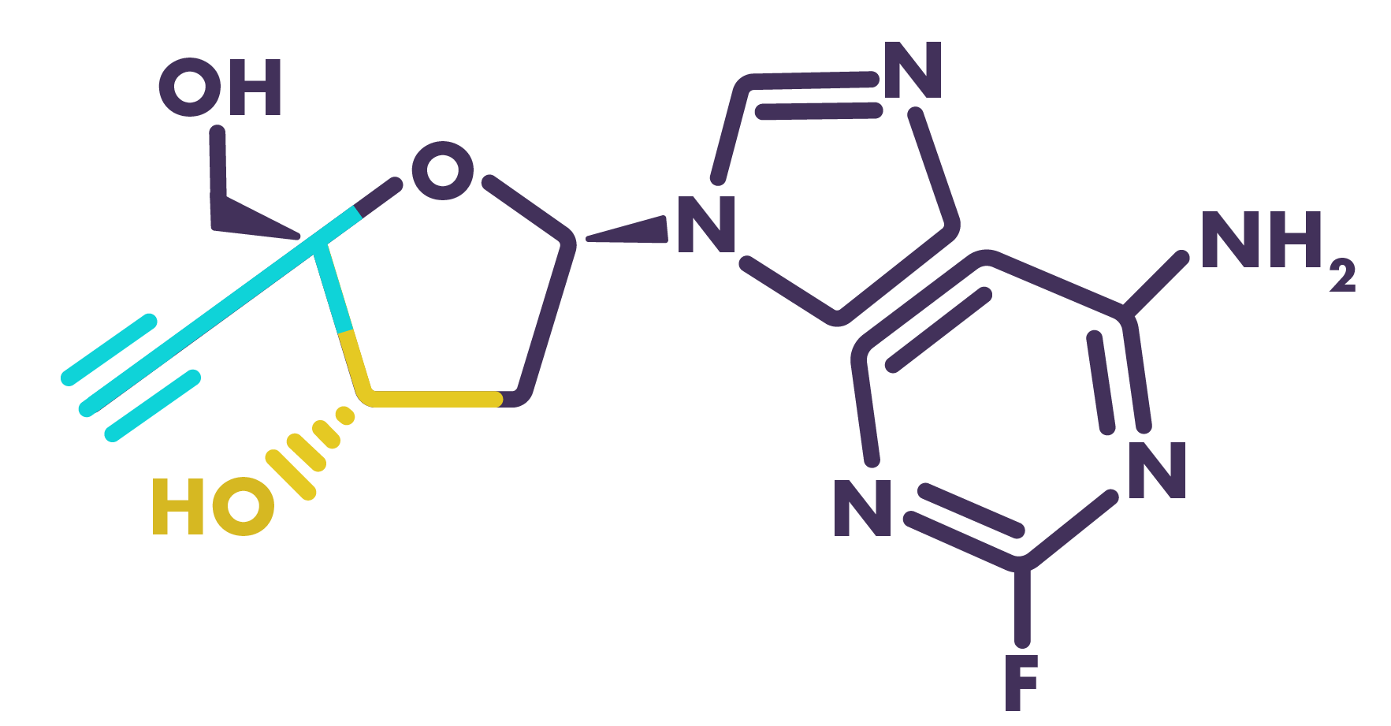

Islatravir (MK-8591):
A First-in-Class Nucleoside Reverse Transcriptase Translocation Inhibitor (NRTTI) With Multiple Mechanisms of Action
Translocation Inhibition
Due to the 4’-ethynyl Group
Delayed Chain Termination
Due to the 4’-ethynyl and 3’-hydroxyl Groups
Multiple mechanisms contribute to the high potency
of islatravir against HIV-1 and drug-resistant variants
and its high barrier to resistance.

Slide 3
Islatravir (ISL) Clinical Development Overview
100
Week 1
Week 3
10 mg
30 mg
100 mg
Oral ISL administered to ~264 individuals to date
  144 healthy study participants, 30 treatment-naïve persons living with HIV (PLWH) in Phase 1
    Single doses ≤400 mg, QD doses ≤5 mg x 6 weeks, QW doses ≤100 mg x3
  ~90 PLWH in Phase 2
    Daily doses ≤2.25 mg for 48+ weeks
Oral Phase 1 development program
  Generally well tolerated
  Linear PK for both parent (plasma) and active triphosphate (TP) in PBMCs over a broad range
    Half-life of parent ISL: 50-60 hr
    Half-life of active ISL-TP in PBMCs: 120-177 hr
  No effect of food on PK
  Antiviral efficacy observed in monotherapy after single doses as low as 0.5 mg
  ISL-TP concentrations in rectal and vaginal tissue similar to PBMC concentrations at steady state
10
ISL-TP Concentration in PBMC
(pmol/10⁶ cells)
1
0.1
0
24
48
72
96
120
144
168
0
24
48
72
96
120
144
168
192
216
240
264
288
312
336
Time (hr)
Time (hr)
Grobler CROI 2016.
0.0
ISL 0.5 mg
ISL 1 mg
ISL 2 mg
-0.5
ISL 10 mg
ISL 30 mg
-1.0
Change From Baseline
HIV-1 RNA (log₁₀ copies/mL)
-1.5
-2.0
-2.5
0
2
4
6
8
10
Matthews IAS 2017.
Time (days)

Slide 4
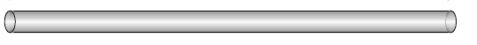
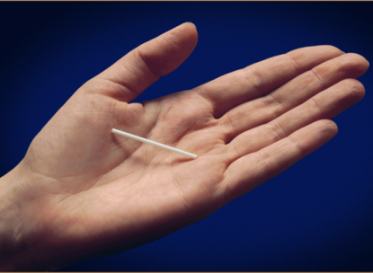
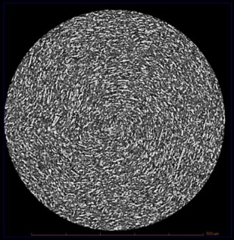
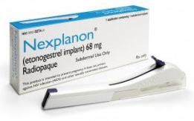
ISL Implant Design Similar to Nexplanon®
2 mm
ISL implant based on Implanon®/Nexplanon®
  Uses same polymer
  Removable (not bioerodible)
4 cm
Able to use Nexplanon® applicator
Initial trial uses prototype implant
Nexplanon®
XRCT of ISL implant
+
Polymer
ISL

Slide 5
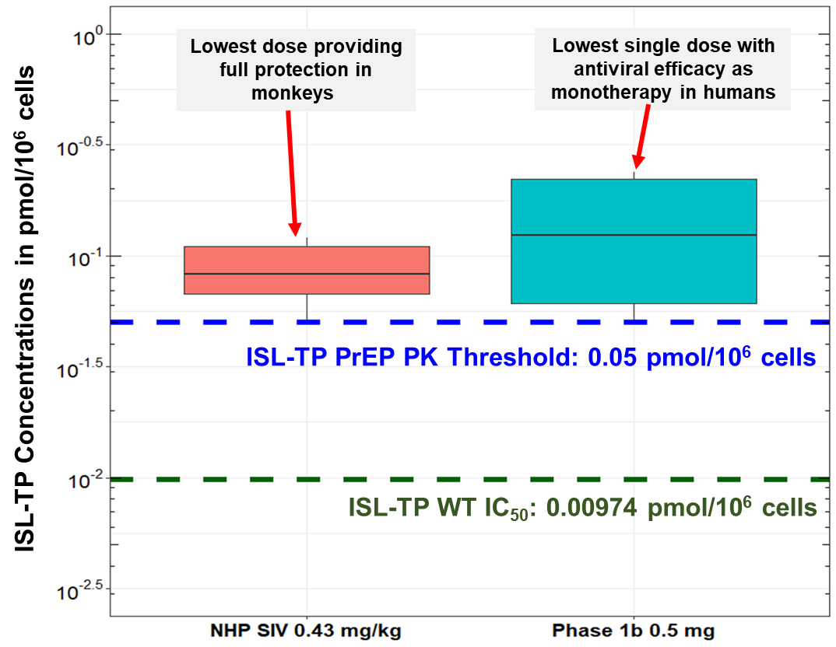
Translational PK/PD Modeling Supports PrEP Exposure Threshold of 0.05 pmol/10⁶ Cells ISL-TP
Threshold of 0.05 pmol/10⁶ cells supported by:
  ISL rhesus macaque SIV study
  Efficacious concentrations at 0.5 mg
0.05 pmol/10⁶ cells = ~5.0x in vitro IC₅₀
  In vitro WT IC₅₀ of ISL-TP is
  ~0.01 pmol/10⁶ cells
  0.05 pmol/10⁶ cells ISL-TP also
  covers in vitro IC₅₀ for M184I/V
Goal is to maintain concentrations above 0.05 pmol/10⁶ cells for the entire duration of implant placement

Slide 6
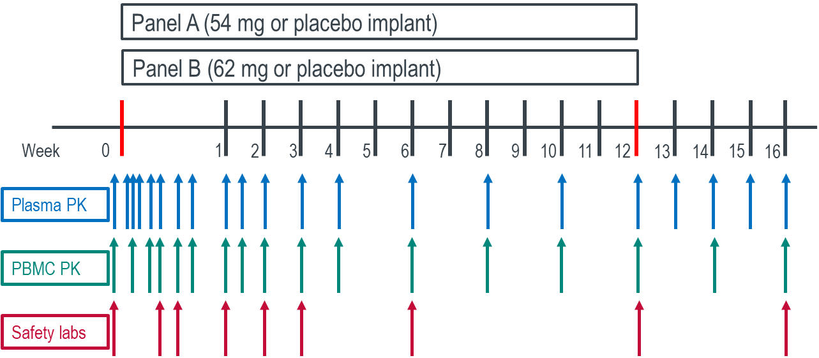
Study Design
Double-blind, placebo-controlled trial in healthy individuals
  Panel A: 54 mg
  Panel B: 62 mg
Eight (6 + 2 design) per panel
Implant placed subdermally in upper arm of nondominant hand
Implant in place 12 weeks, followed by 4 weeks post-removal
PK (plasma and PBMC), ECGs, vital signs, safety labs collected throughout
Study Objectives
Assess safety and tolerability of an islatravir-eluting implant placed for 12 weeks
Characterize the PK profiles of ISL and ISL-TP, and estimate the time at which the concentration of ISL-TP would fall below 0.05 pmol/10⁶ cells

Slide 7
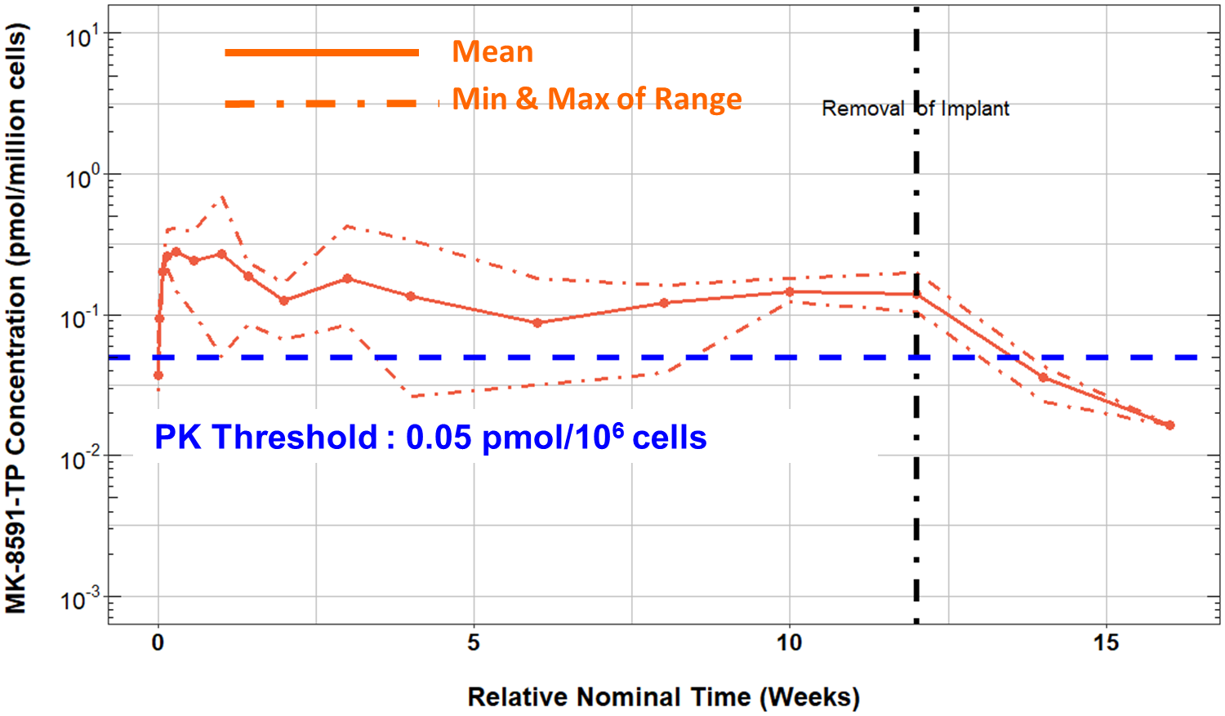
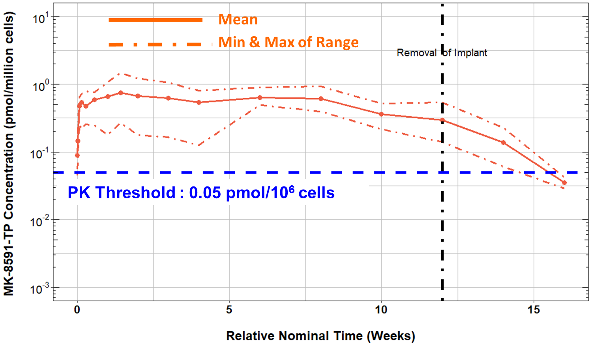
Intracellular ISL-TP PK Threshold of 0.05 pmol/10⁶ Cells Maintained Throughout Placement for Both Doses
54 mg Implant
62 mg Implant
ISL-TP (pmol/10⁶ cells)
ISL-TP (pmol/10⁶ cells)
Ratio of TP/plasma remains fairly constant at ~1000:1 – consistent with oral dosing
Half-life after removal of implant similar to half-life of orally dosed ISL

Slide 8
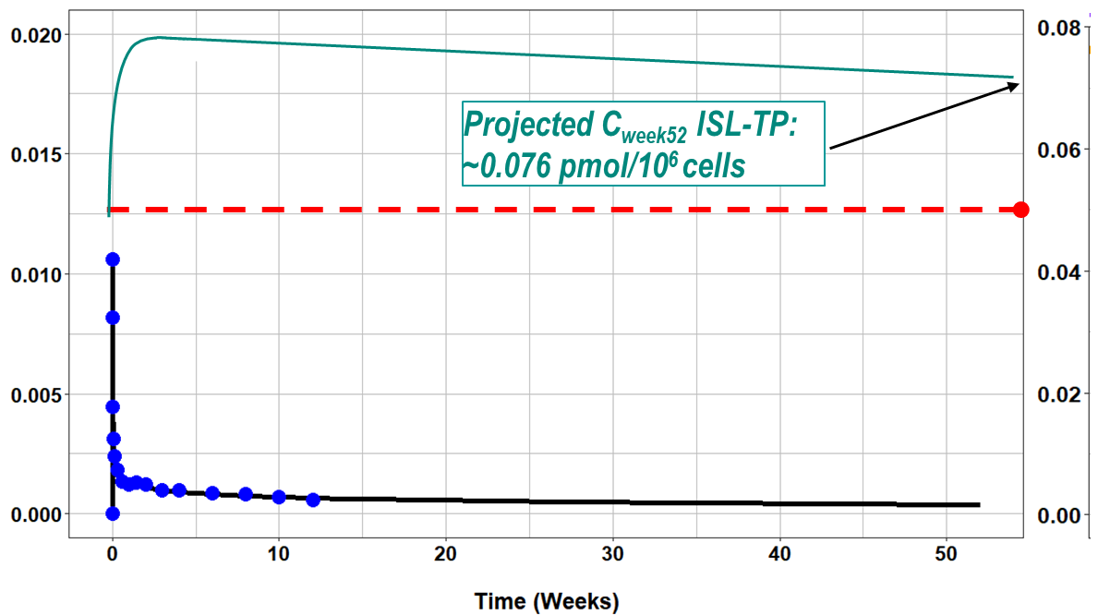
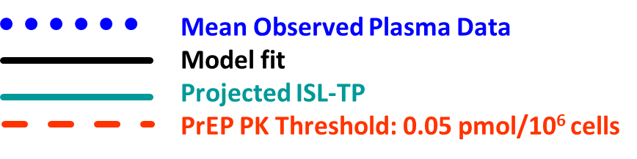
62 mg Implant Projected to Lead to Concentrations Above Threshold for at Least 12 Months
0.08
0.06
ISL plasma concentrations (µM)
0.04
ISL-TP concentrations (pmol/10⁶ cells)
0.02
0.00
62 mg implant will continue to release through 52 weeks
ISL-TP should be above threshold (0.05 pmol/10⁶ cells) for >12 months
  Projected concentration at 12 months: 0.076 pmol/10⁶ cells
  Projected time at which concentration falls below 0.05 pmol/10⁶ cells: 68-70 weeks (~16 months)

Slide 9
Safety Summary
Generally Mild Local Tolerability Effects; No Systemic Effects Noted
Implants generally well tolerated through 12 weeks
  16/16 subjects reported at least 1 adverse event (AE)
  All drug-associated AEs were mild or moderate in severity
  No serious AEs and no discontinuations due to an AE
  Types of AEs observed consistent with those observed with other implants; hematoma and pain/tenderness generally noted after placement or removal procedure
Adverse Event (mild unless noted) | Placebo (N=4) | 54 mg Implant (N=6) | 62 mg Implant (N=6)
Implant site hematoma | 4 (100%) | 6 (100%) | 6 (100%)
Implant site pain/tenderness | 2 (50%) | 3 (50%); 1/3 moderate | 6 (100%); 2/6 moderate
Implant site erythema | 0 (0%) | 2 (33%) | 5 (83%); 1/5 moderate
Implant site induration | 0 (0%) | 5 (83%) | 6 (100%)
Implant site pruritus | 1 (25%) | 0 (0%) | 5 (83%)
In pooled analysis of vital signs, ECG parameters, and safety laboratory studies, there were no clinically significant differences between the placebo group and the 2 implant groups
No clinically significant outlying values in any individual set of vital signs, ECG parameters, or safety
laboratory studies

Slide 10
Conclusions
ISL prototype implants were generally well tolerated, with no discontinuations due to an AE and no severe implant-related AEs
  No laboratory or other signs of systemic reactions
  Local tolerability (erythema, induration) generally mild and possibly dose dependent
Both implants (54 and 62 mg) had concentrations above PK threshold at 12 weeks
  62 mg implant projected to be well above threshold at 12 months and likely for several months beyond
  Supports potential of the ISL implant as a once-yearly PrEP option

Slide 11
Acknowledgments
Translational Pharmacology
Vanessa Levine
Guo Chen
Liesbeth Haspeslagh
Marian Iwamoto
Aubrey Stoch
Pharmacokinetics/Pharmacodynamics
and Drug Metabolism
Munjal Patel
Kerry Fillgrove
Melanie Anderson
Ryan Vargo
Biostatistics
Sandra Zhang
Implant Formulation
Stephanie Barrett
Biopharmaceutics
Wei Zhu
Global Clinical Development
Mike Robertson
Discovery Biology
Jay Grobler
Safety Assessment and Laboratory Animal Resources
Ray Gonzalez
Regulatory Affairs
Anita Shaw
Project Management
Nathan Kreischer
https://bit.ly/2YjlnPG
Drug Research Unit Ghent
Sylvie Rottey (PI)
All the study participants
Merck Sharp & Dohme Corp., a subsidiary of Merck & Co., Inc., Kenilworth, NJ, USA, provided financial support for the study.

